Slide 1

Superstore Sales Data Analysis Report SQL Part
Introduction
This report aims to analyze Superstore sales data using SQL queries to extract key insights about sales, customers, and products. The report includes various analyses, such as sales by category, regions, and top customers.

Slide 2

Dataset Description
The sales data used in this report comes from two sources:
superstore sales dataset (The raw dataset before cleaning).
cleaned_superstore_sales_dataset (The dataset after data cleaning).
Key Analyses Covered in the Report:
Sales analysis by category and region.
Identifying top-selling products and best customers.
Recognizing patterns in sales data.

Slide 3
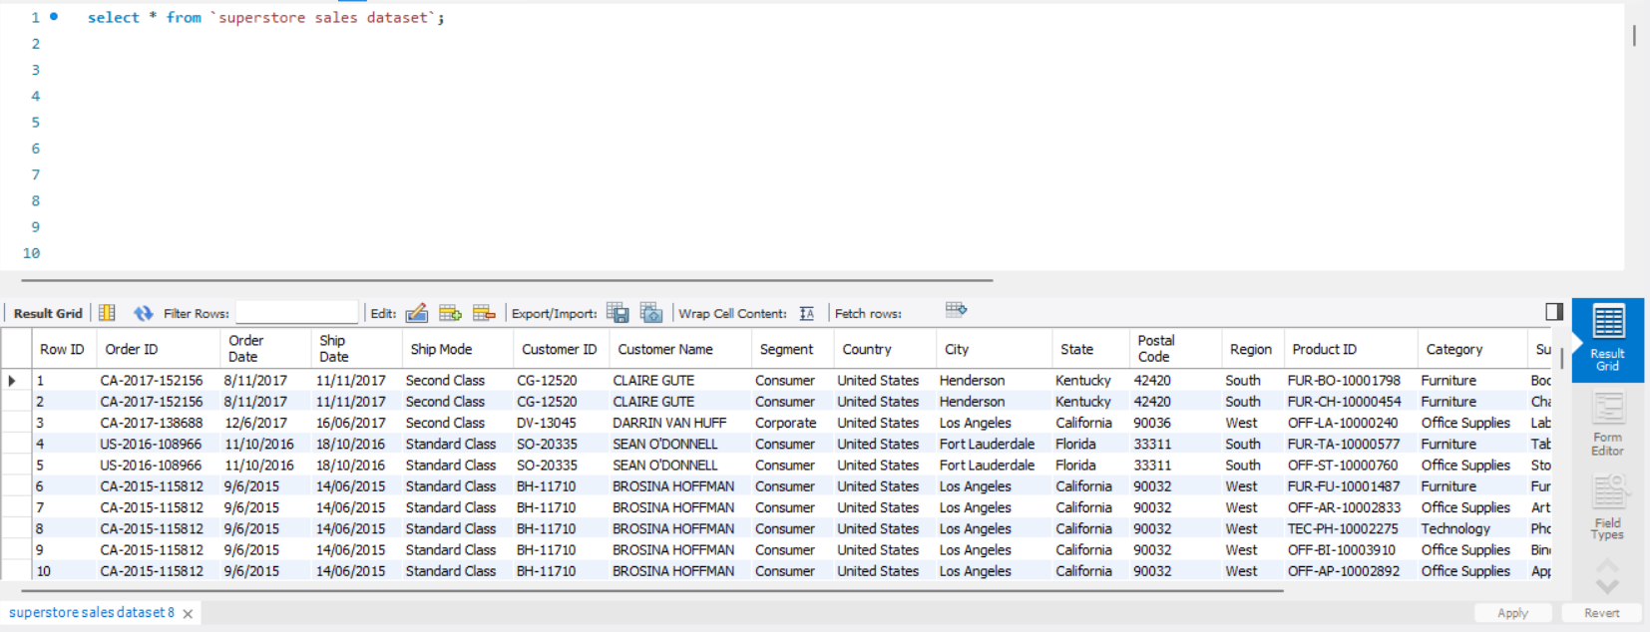
Exploring the Dataset
Explanation: This query fetches all records from dataset for an initial review.

Slide 4
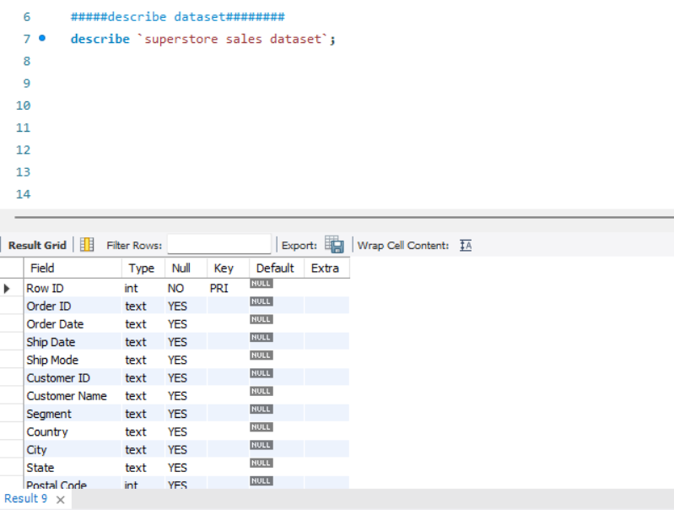
Explanation: Displays column names, data types, and constraints for understanding the dataset structure.
Describing the Dataset Structure

Slide 5
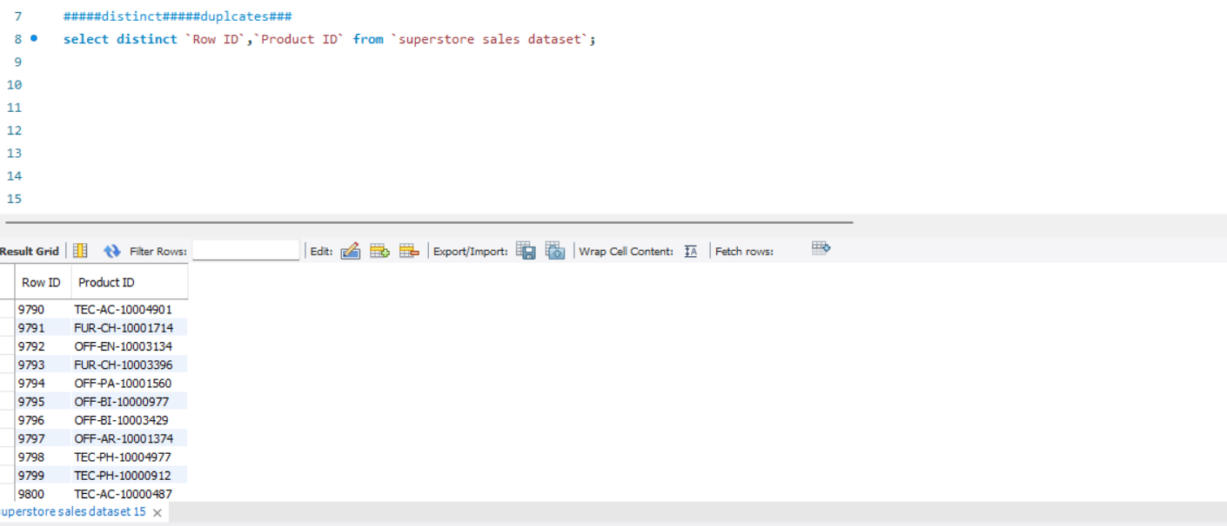
Checking for Unique Row ID and product ID

Slide 6
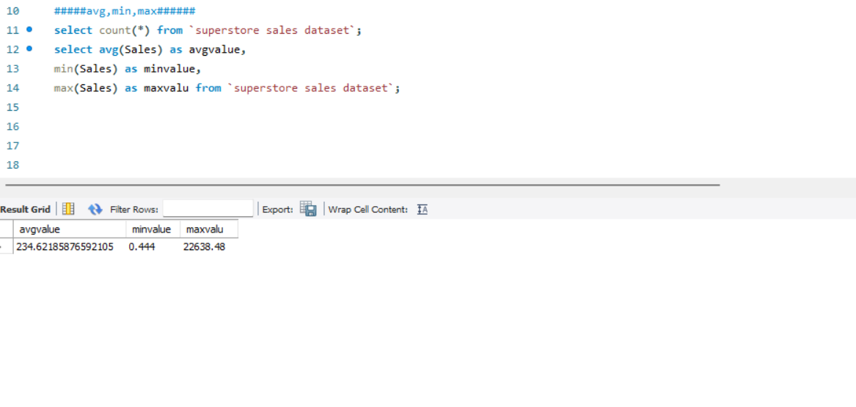
Basic Sales Statistics

Slide 7
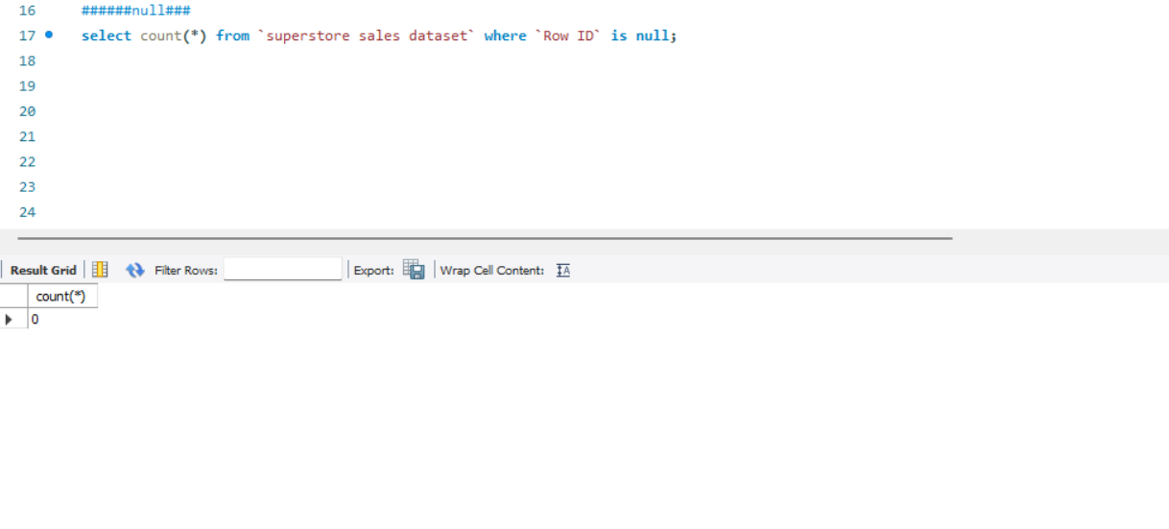
Checking for Null Values in Row ID

Slide 8
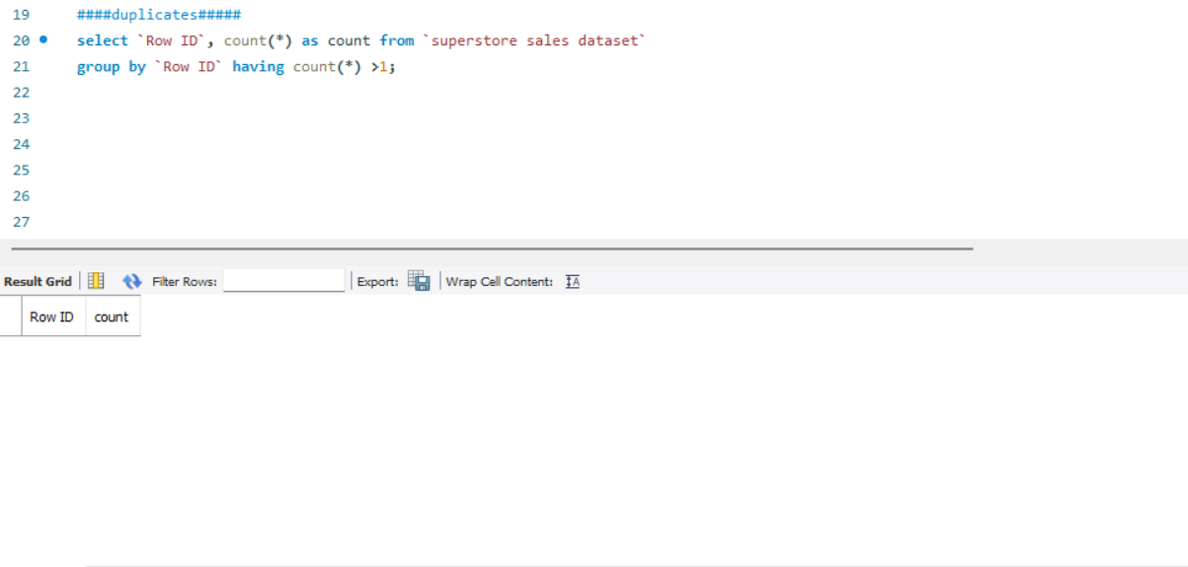
Finding Duplicate purchase

Slide 9
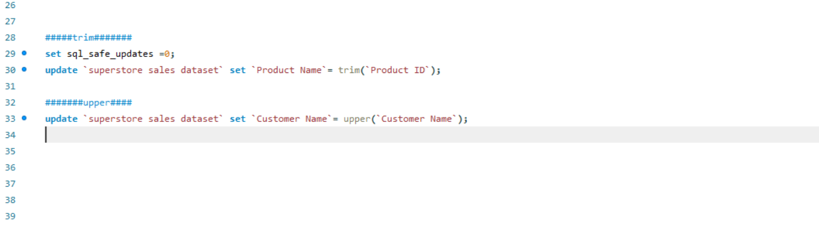
Data Formatting

Slide 10
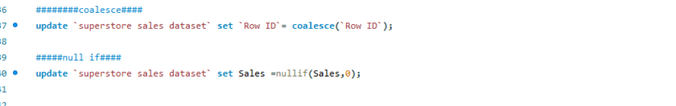
Data Cleaning: Handling Null Values in Row ID and Setting Sales to Null When It’s Zero

Slide 11

Analysis questions phase

Slide 12
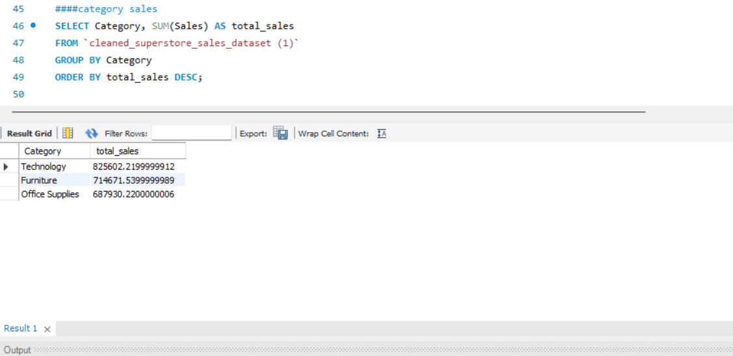
Sales by category: Identifies top-selling categories, helping determine the most profitable product groups.

Slide 13
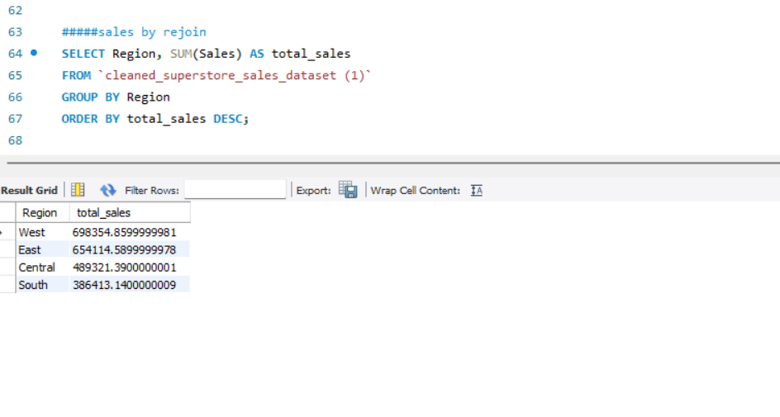
Sales by Region: Helps determine the regions generating the highest sales.

Slide 14
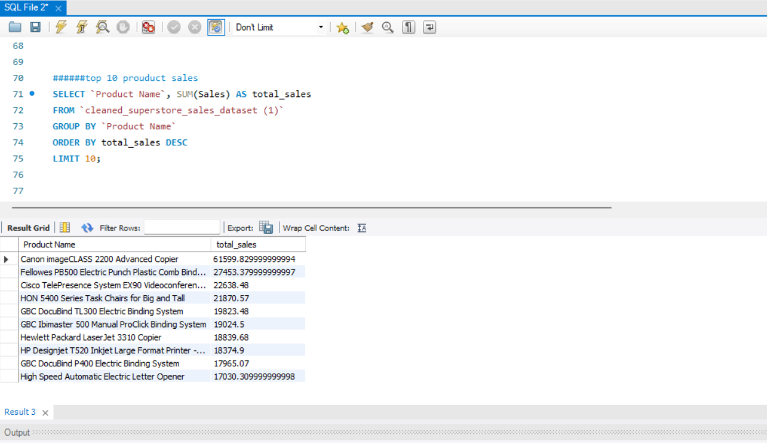
Top 10 Best-Selling Products

Slide 15
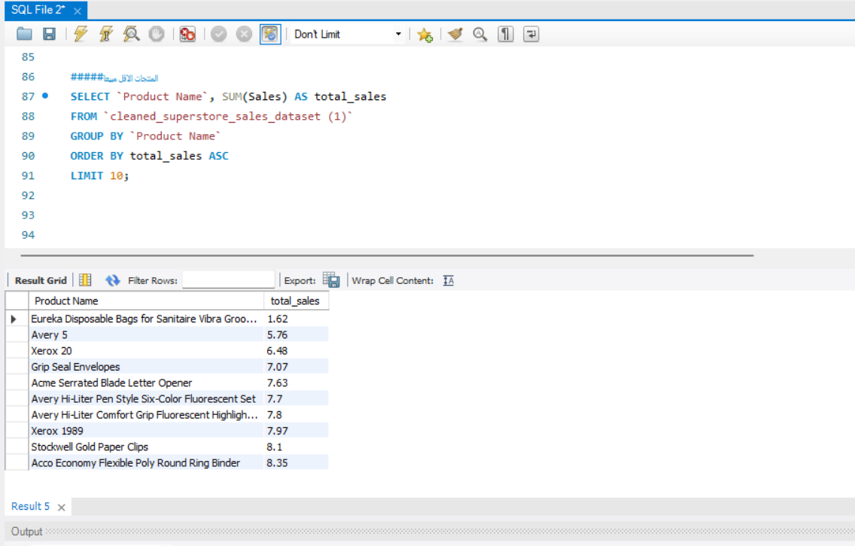
Least-Selling Products

Slide 16
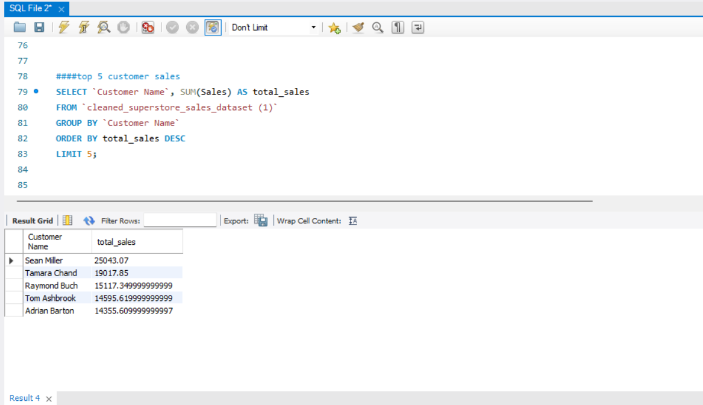
Top 5 Customers by Sales

Slide 17
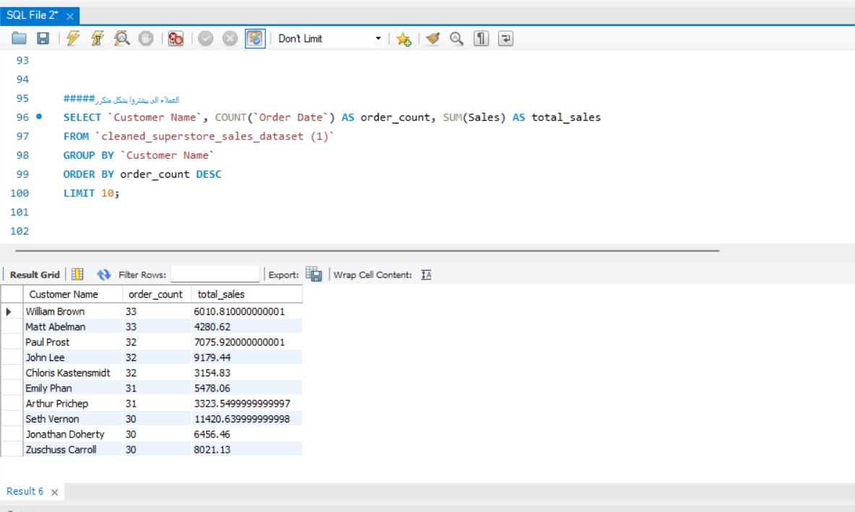
Frequent Customers Analysis

Slide 18
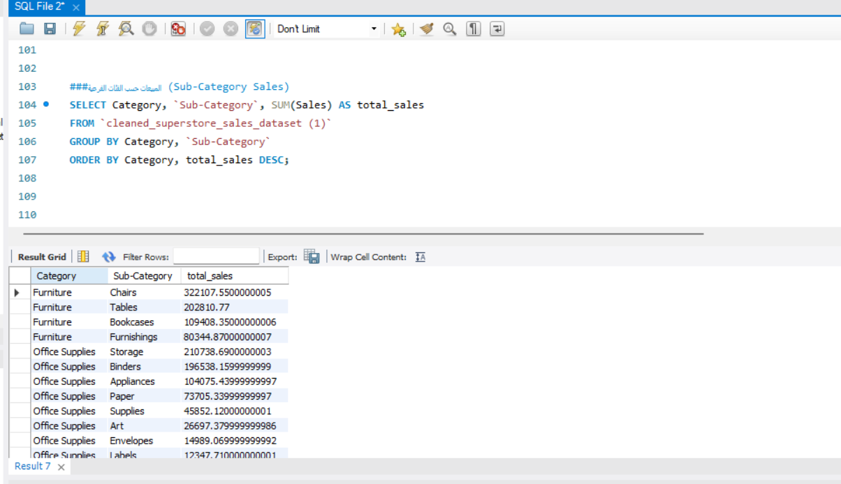
Sub-Category Sales Analysis

Slide 19
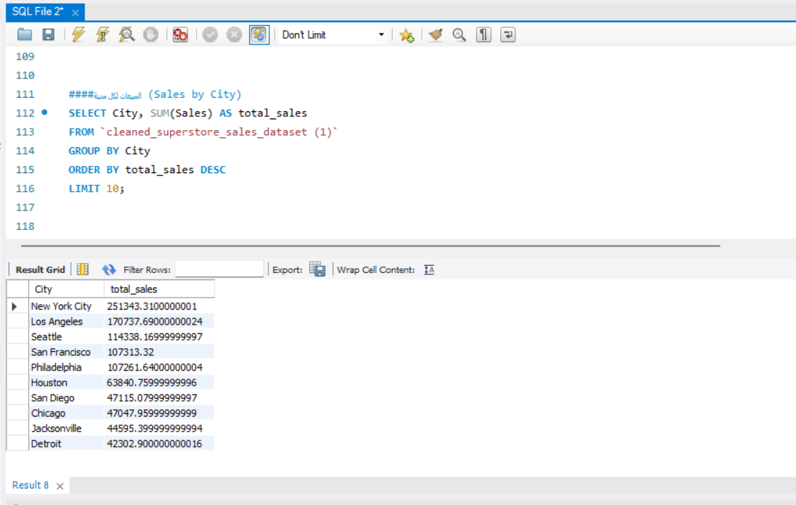
Sales by City

Slide 20
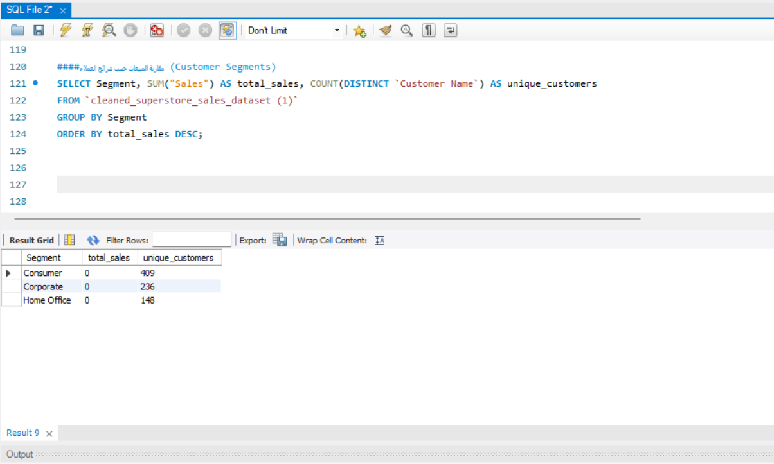
Customer Segments Sales Comparison

Slide 21
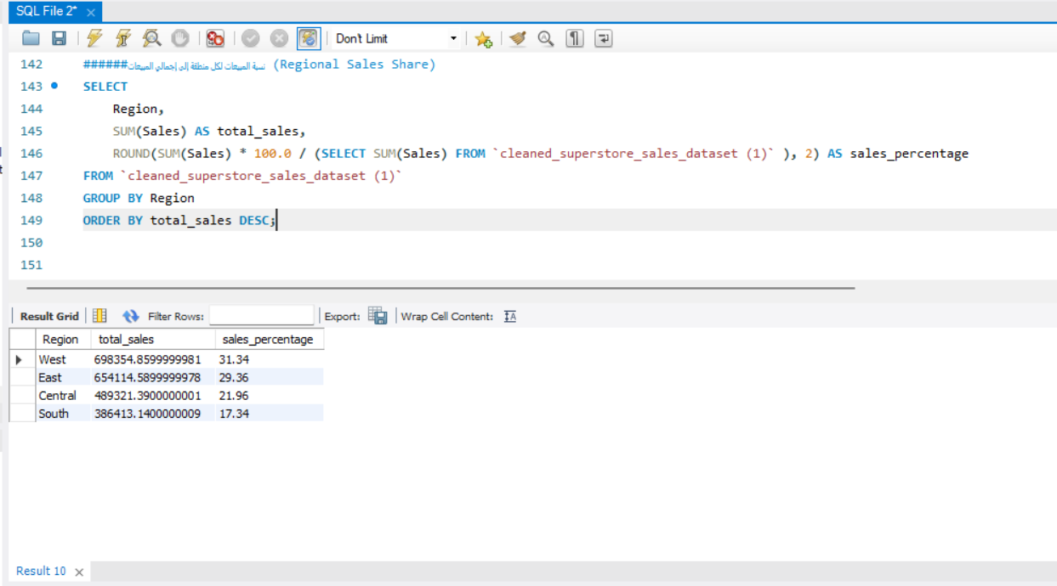
Regional Sales Contribution to Total Sales

Slide 22
Conclusions and Recommendations
Certain categories and products generate high sales, which can be leveraged for promotions.
Specific regions outperform others, requiring focused marketing strategies.
Poorly performing products may need reevaluation for better sales strategies.
Identifying repeat customers allows for enhanced retention strategies.
Recommendation: Utilize these insights to drive data-informed business decisions.

Slide 23
Superstore Sales Data Analysis Report Python Part
Introduction
This report analyzes Superstore sales data using Python and Pandas. The objective is to clean, process, and extract insights from the dataset. The analysis includes data cleaning, summary statistics, sales trends, and visualizations.

Slide 24

Data cleaning and preprocessing

Slide 25
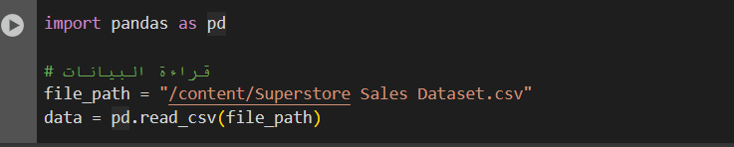
Data Loading: Explanation: Uploading our data on google colab.

Slide 26
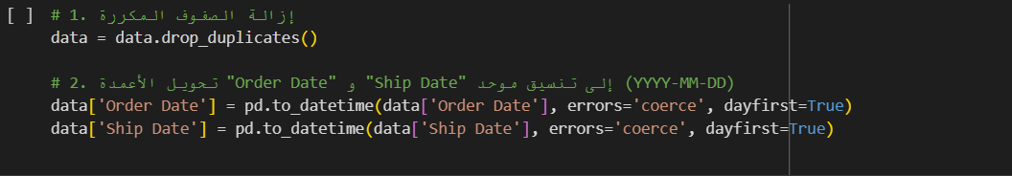
Data Cleaning: Explanation: Removing Duplicates

Slide 27
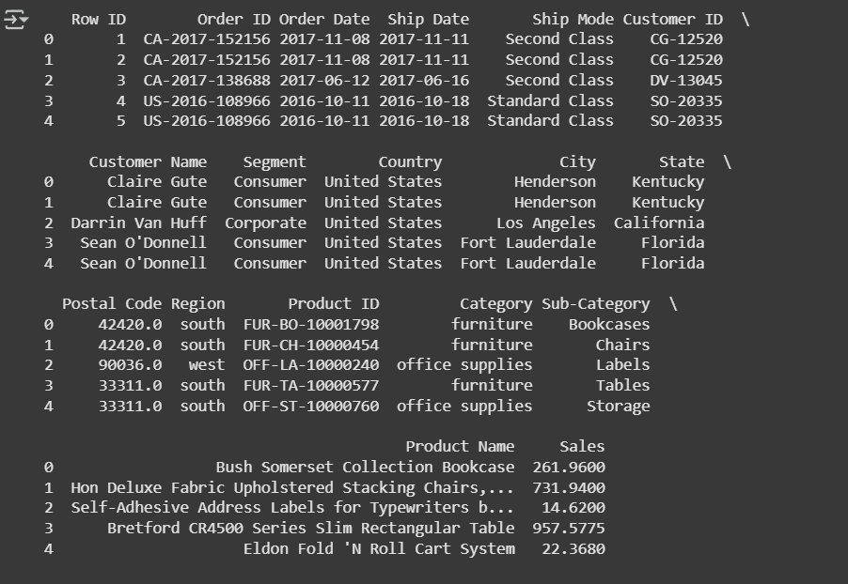
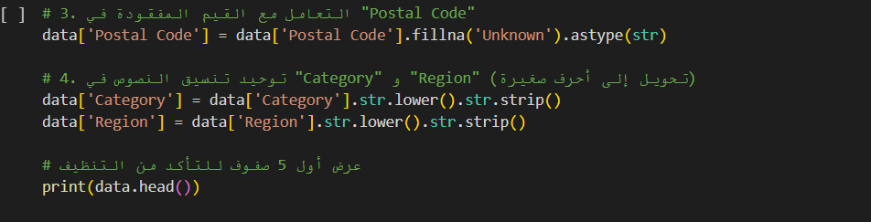
Data Cleaning: Explanation: Handling missing values and checking the first 5 rows.

Slide 28
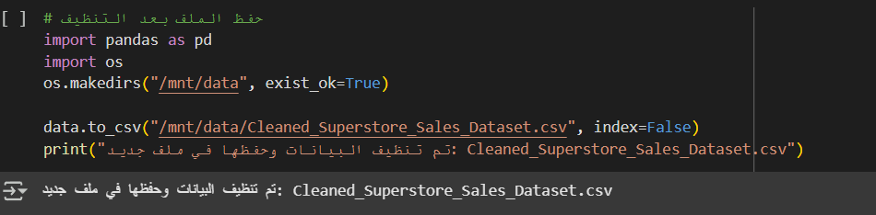
Data Cleaning: Explanation: Saving the cleaned dataset.

Slide 29
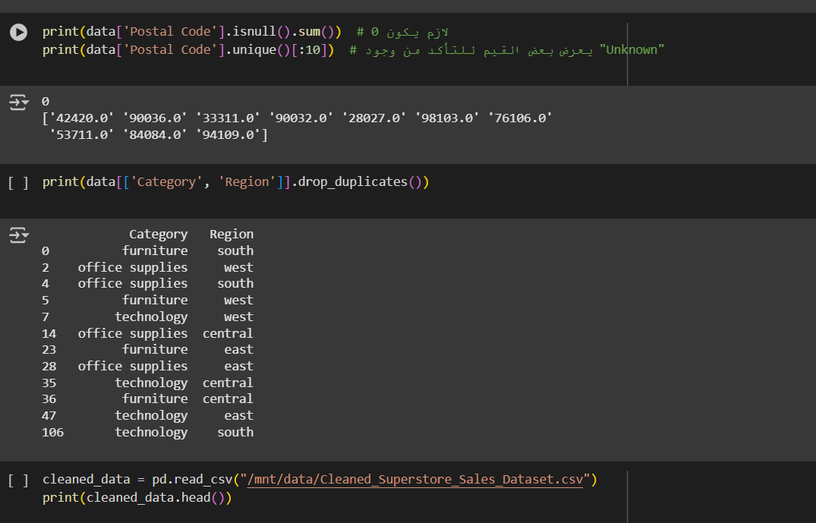
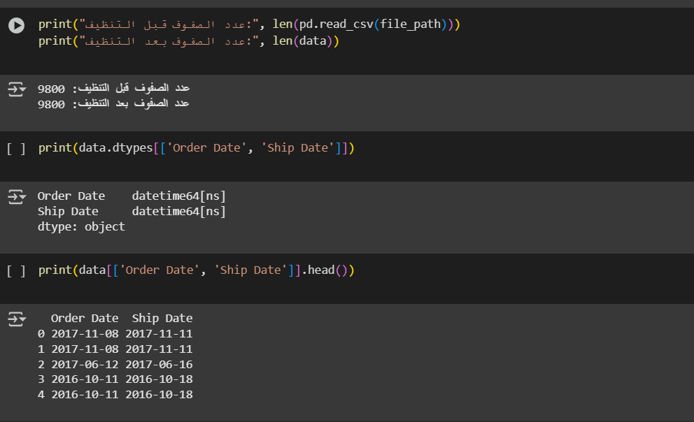
Data Cleaning

Slide 30
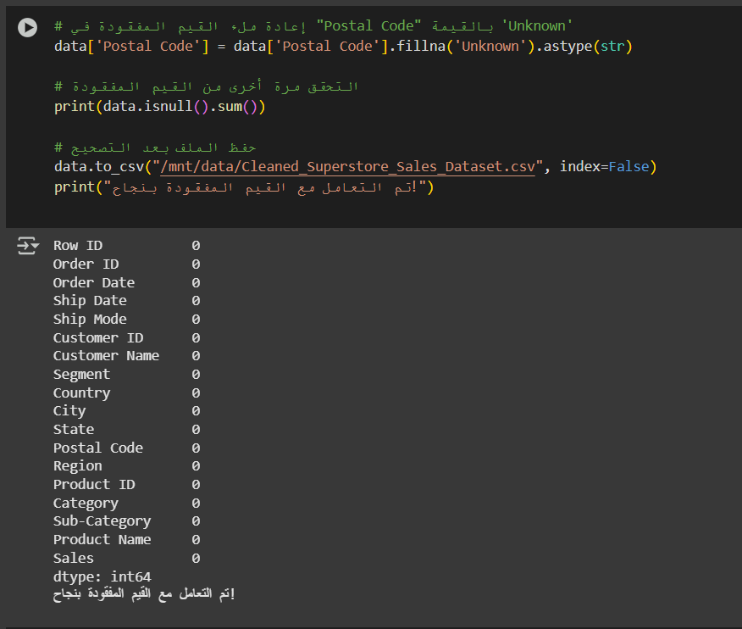
Dealing with missing data

Slide 31
Analysis questions phase

Slide 32
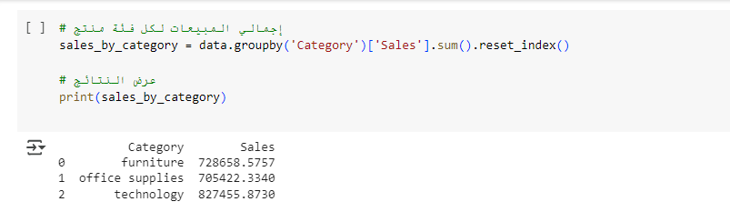
Total Sales Per Category

Slide 33
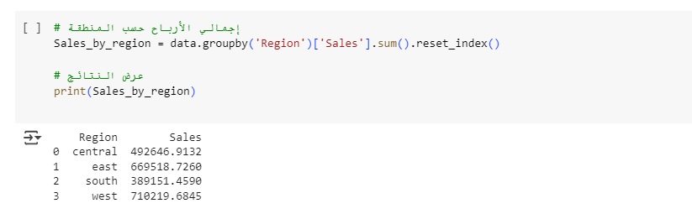
Total Sales Per Region

Slide 34
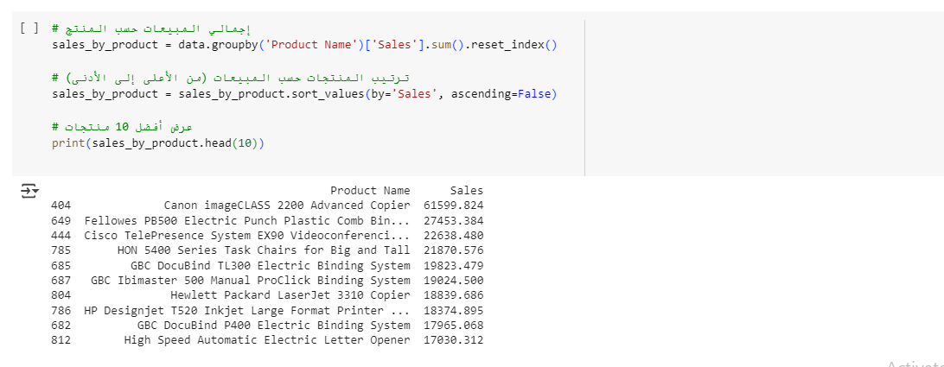
Total Sales Per Product

Slide 35
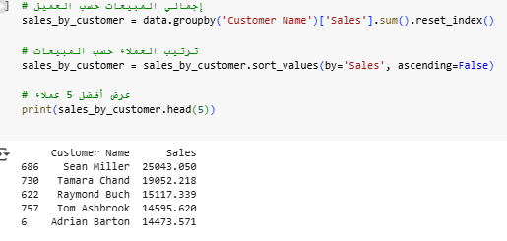
The top 5 customers based on sales.

Slide 36
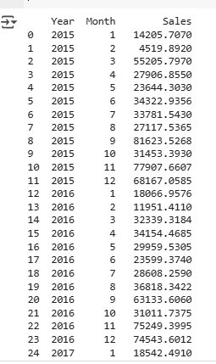
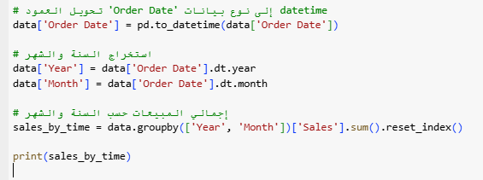
Sales by time

Slide 37
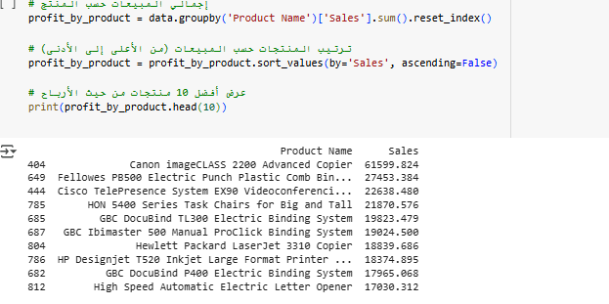
The top 10 products in terms of profit.

Slide 38

Forecasting questions phase

Slide 39
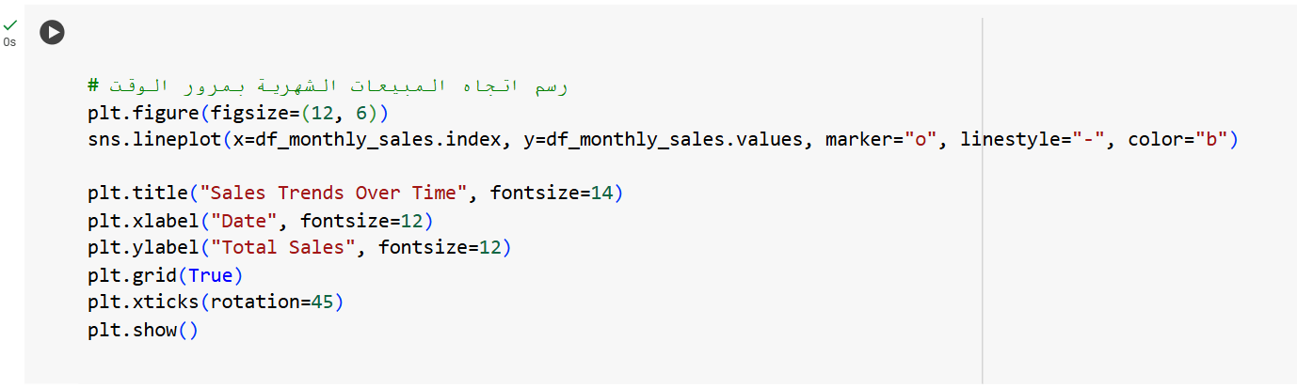
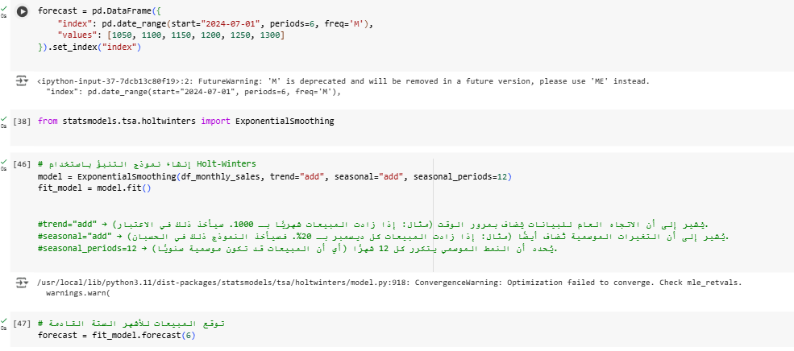
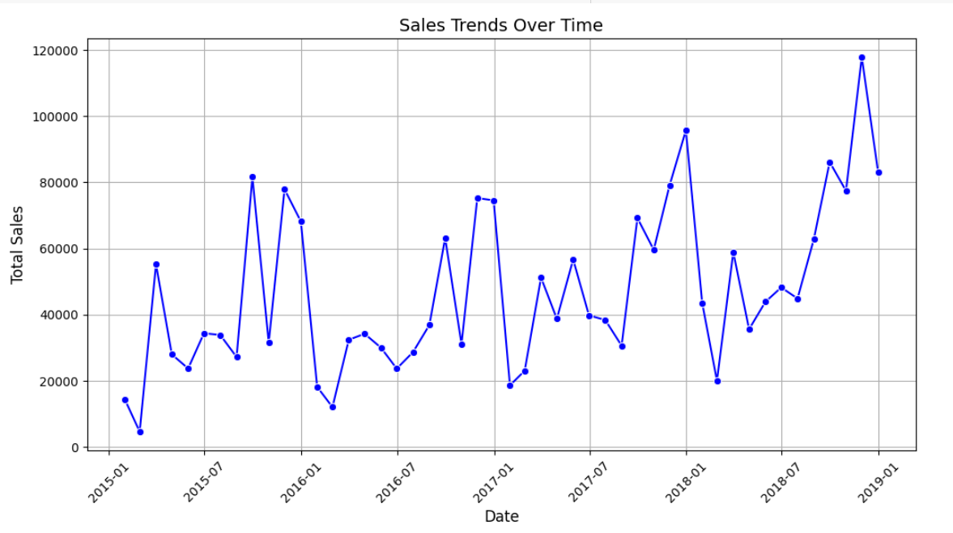
Trend of Sales

Slide 40
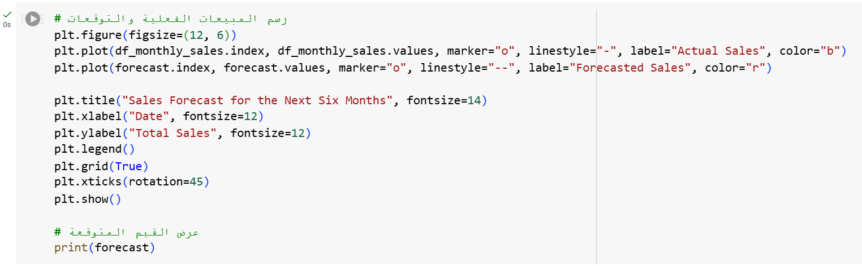
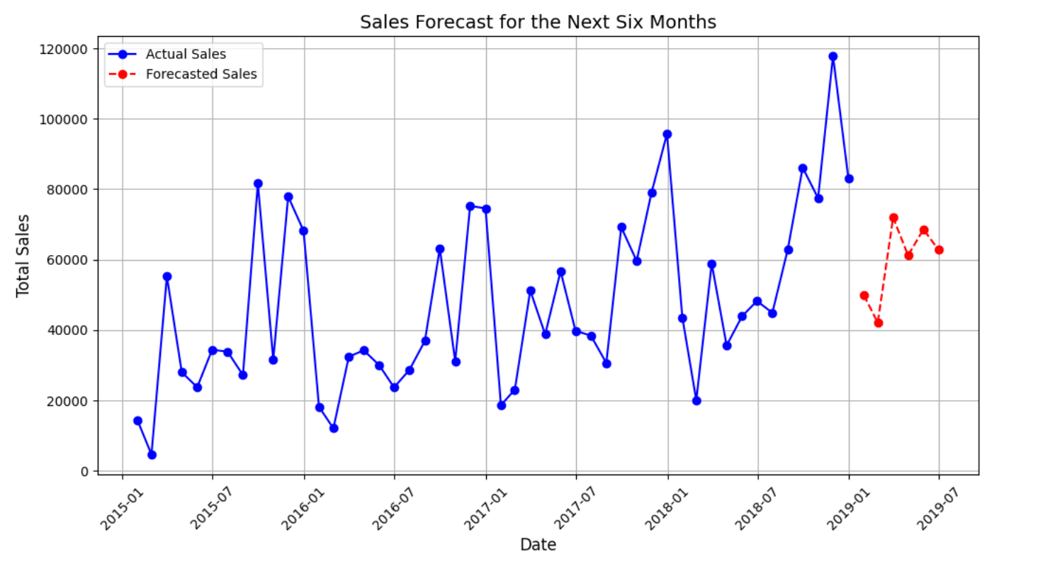
Sales Forecast for Next Six Month

Slide 41
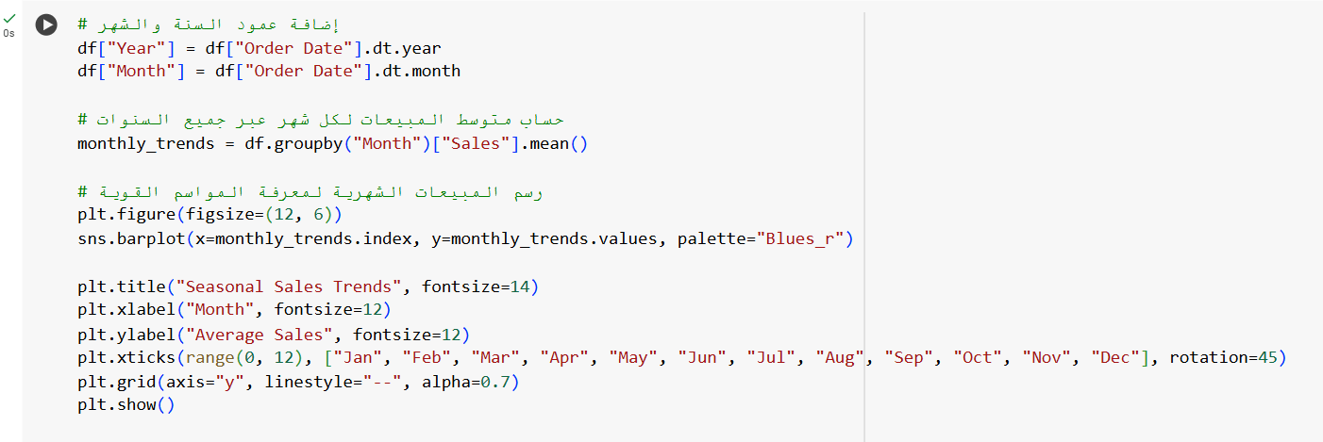
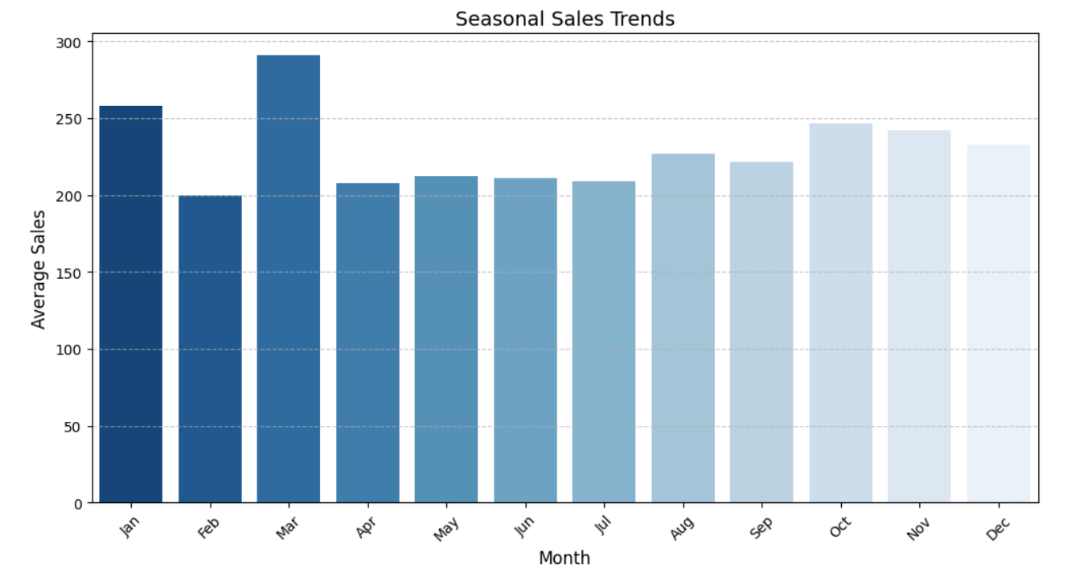
Seasonal sales trends

Slide 42
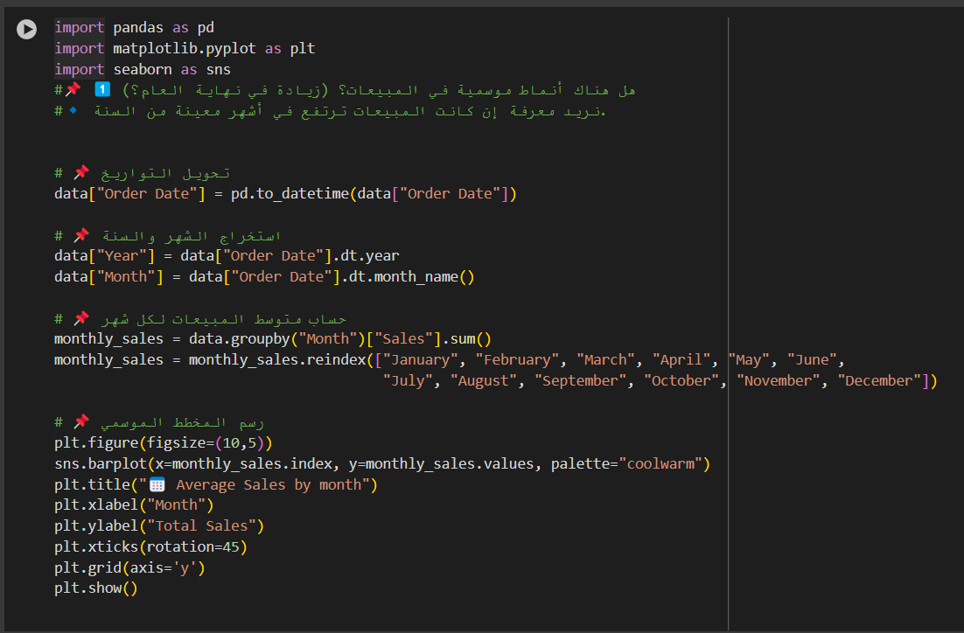
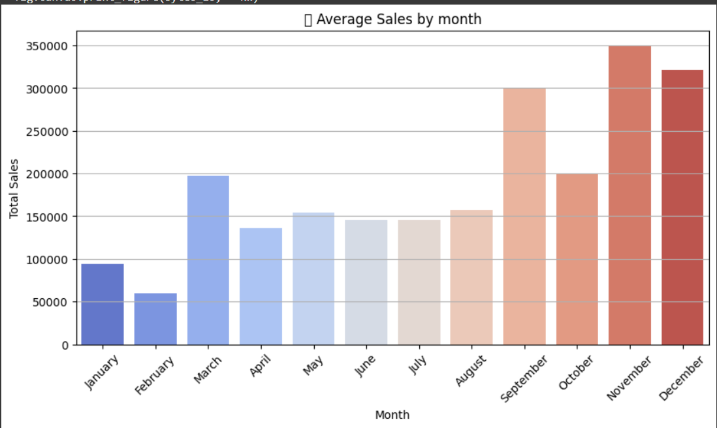
Sales by Year & Month: Explanation: Analyzes monthly and yearly sales trends.

Slide 43
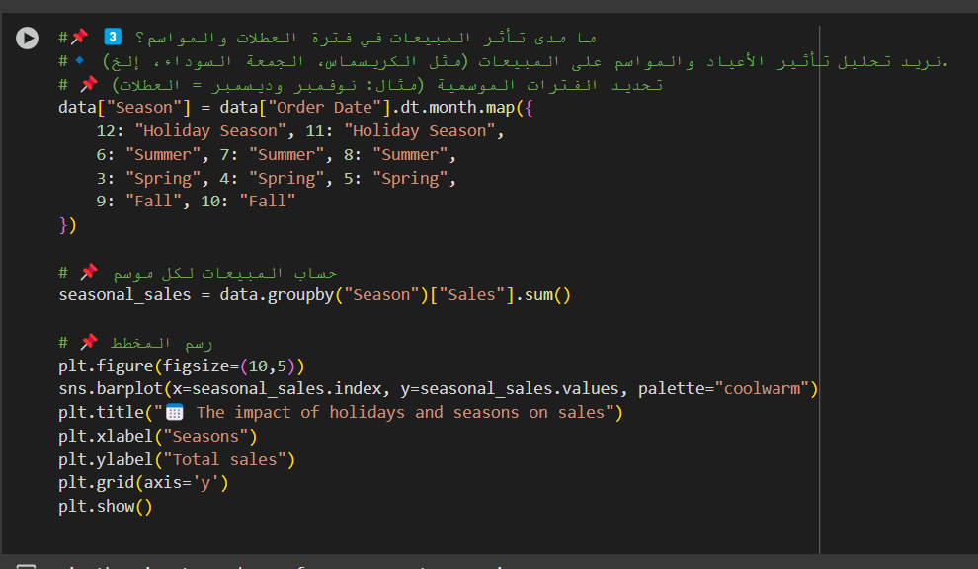
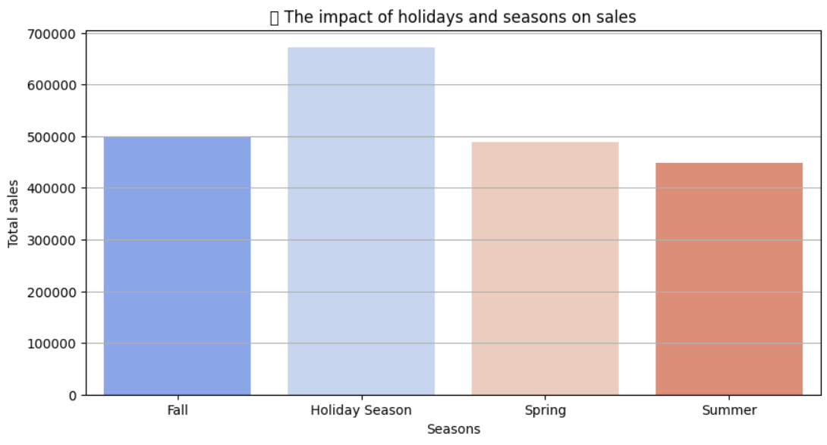
Seasonal Sales Patterns:
Explanation: Visualizes sales trends over different months.

Slide 44
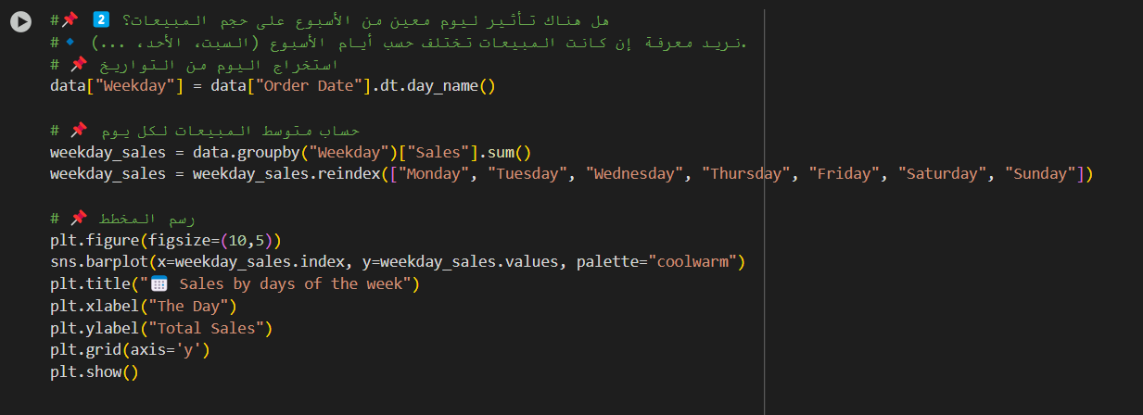
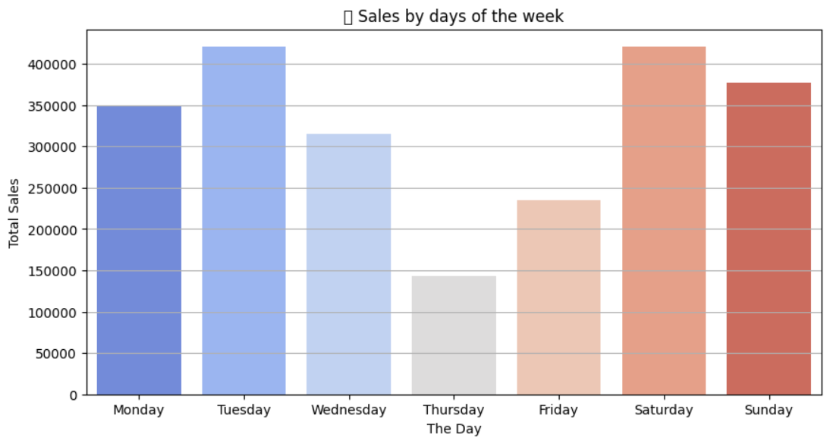
Sales by Day of the Week:
Explanation: Analyzes how sales vary across different weekdays.

Slide 45
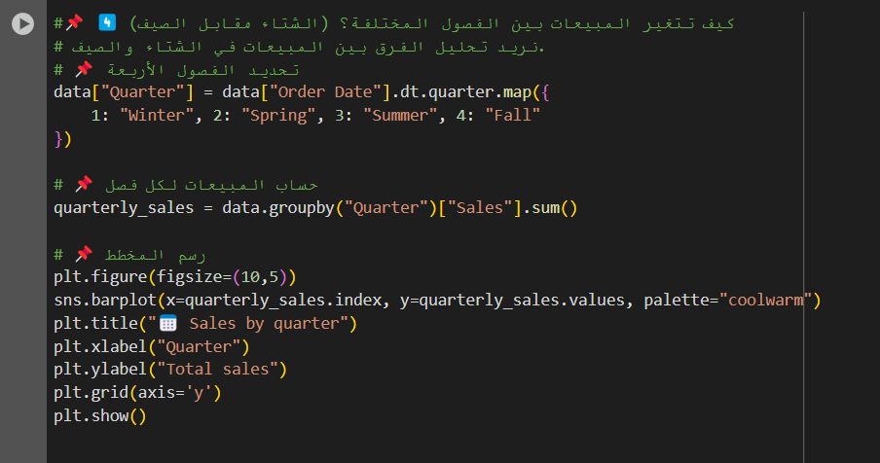
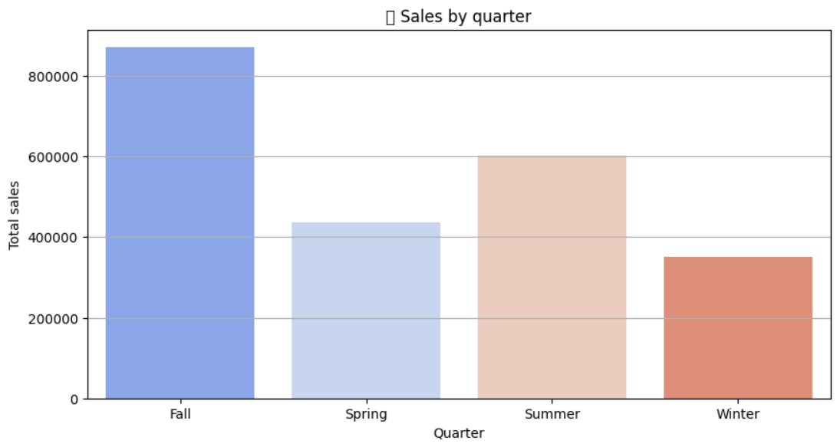
Sales by Season (Holidays vs. Regular Periods): Explanation: Determines the effect of different seasons on sales

Slide 46
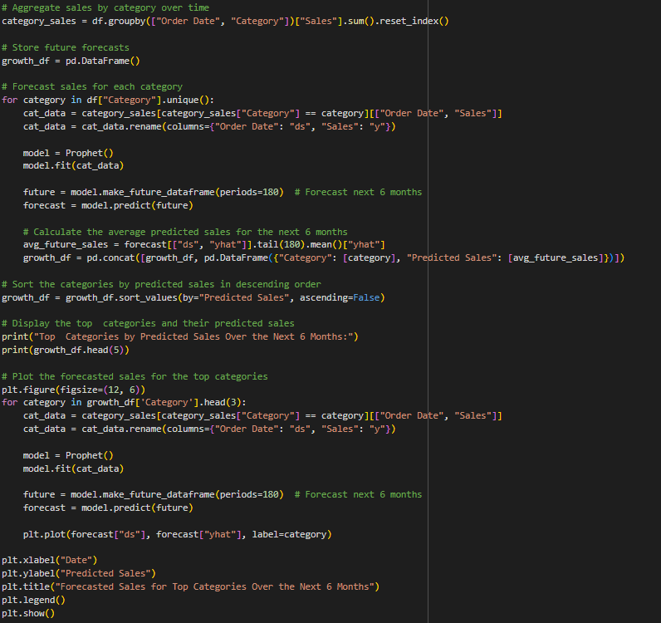
Forecasted Top sales in the next 6 months

Slide 47
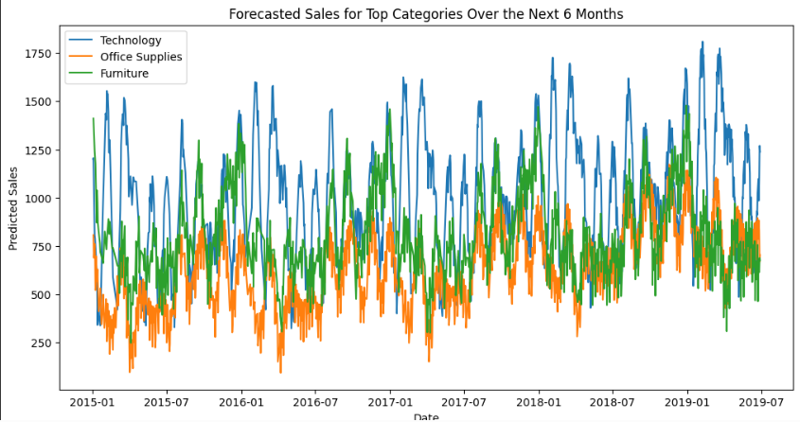

Slide 48

Forecasted Top sales in the next 6 months- Histogram

Slide 49


Slide 50

Forecasted declining products

Slide 51


Slide 52


Analysis sales every region over the year

Slide 53


Determine the state with the highest growth

Slide 54


The region with the longest shipping time is Central

Slide 55

The state with the highest sales growth.

Slide 56


The region with the highest sales growth.

Slide 57

Forecasting customer behavior

Slide 58


Slide 59

Sales per section

Slide 60


Slide 61

Sales trend across the month

Slide 62


Slide 63


Impact of expansion on sales

Slide 64


Top 15 Cities by Sales

Slide 65


Price Elasticity of Demand

Slide 66


Slide 67


The impact of promotional campaigns on sales

Slide 68


Slide 69

Tableau Visualization Dashboard

Slide 70

Sales by State

Slide 71

Sales over time

Slide 72

Sales by category

Slide 73

Sales by subcategory

Slide 74

Top 10 customers

Slide 75
Final Dashboard

Slide 76


